Slide 1
TECH460 Final Project: Rosetta Stone Java Interface
Marvin Ziegler
November 2022
December 8, 2022
Notes:
My name is Marvin Ziegler. My course project presentation involves a Java Graphical User Interface (GUI) that’s intended to be used by Rosetta Stone. Its purpose is to enhance the functionality of their existing software language learning program.
28

Slide 2
Introduction
This project proposes a plan to add drop-down list functionality to the User Experience (UX) provided by the Rosetta Stone language learning system. Major components of this presentation are:
Organization profile and problem statement
Technology selection and design
Implementation plan
Notes:
The project proposes the addition of drop-down list functionality to their existing User Interface. This would allow word substitution capability, thus allowing learners to increase their foreign language vocabulary.
The first part of the presentation tells about the company and introduces a problem statement. Solving the problem will lead to an improvement in their existing software product.
The second part tells about the technology that will be used to solve the problem. It includes a couple of pictures that depicts how it's designed towards improving the existing User Experience.
The third part is details on how the plan will be carried out. It takes into consideration the near future and future that is more distant.
28

Slide 3
Executive Summary
Language learners who use Rosetta Stone software can quickly expand foreign vocabulary through drop-down list functionality on certain words in sentences.
Analysis shows that learners can become much more flexible in their vocabulary if such a technology were implemented.
This proposal suggests the implementation of a Java GUI (Graphical User Interface) that will allow for drop-down list capability.
Other methods of drop-down list functionality were examined. It turns out that a Java UI would be more secure and have more user interface options available among other advantages.
A plan to implement proposed Java GUI is outlined. It includes considerations for WBS, schedule, validation, evaluation and continuous improvement into the future. Legal, ethical, and cultural concerns were also considered.
Notes:
The executive summary is a story of what the project entails in a nutshell.
The first bullet introduces an idea that can benefit Rosetta Stone language learners.
The next bullet tells how the idea can be beneficial.
Then the technology that's used to make the functionality is mentioned.
The fourth bullet mentions one of the advantages of the selected technology over technologies that weren’t chosen.
The last bullet talks about the plan for going forward with the selected technology.
28

Slide 4
Organization Profile and Problem Statement
The Organization
Products and Services
Areas for Improvement with Technology
Problem Statement
Notes:
This section introduces the company to the viewer. It provides background on the company itself; then tells what goods and services it provides.
Then it identifies an area where the company's product offering can be enhanced or improved. This in turn leads to the problem statement.
28

Slide 5
The Organization
Rosetta Stone Ltd.
Uses computer technology to simulate an innovative method for language learning. This method utilizes the same method that people learn their natural language. It involves the use of sounds and pictures in context along with the absence of translation.
Main Competitors: Berlitz Corp, Mastery Education, Pearson plc, Scholastic Corp
Public Company established in 1992.
1147 Employees
Brand awareness is 68% in USA, used by 16% of online education providers
Sales decrease from 217M in 2015 to 173M in 2018, but increase to 190M in 2020.
Profits decrease from 46M in 2015 to 1M in 2017, but increase to 12M in 2020.
Acquired by IXL Learning in 2021
Source: Statista, 2022; Plunkett Research, 2022
Notes:
The name of the organization is Rosetta Stone. It's product is a software program that offers language learning in a way that people learn their own native language from childhood.
There's info about what companies compete with Rosetta Stone. Also there's other pertinent company info that should be looked at when considering ways to improve their product offering.
28

Slide 6
Products and Services
Products:
Previously offered language-learning software via CD-ROM (Compact Disc, Read Only Memory) or download.
Currently there’s no indication that this
is one of their offerings.
Gift memberships to friends and family can possibly be considered as a product.
Services:
Membership option (online subscription) for a single language under 2 different payment plans.
Lifetime membership option that includes all available languages.
Separate subscription plans for enterprises and schools.
Live coaching from native speakers.
Language learning via Rosetta Stone app
Source: Rosetta Stone, 2022
Notes:
Rosetta Stone mostly offers language-learning services through a variety of subscription options. There are plans available for individuals, there's also different options for businesses and schools.
Previously the software product was available on Compact Disc. As far as I can tell, this no longer seems to be the case.
28

Slide 7
Areas for Improvement with Technology
Part 1
Mouse-over translations for words (with encouragement to use context to understand meaning prior to attempting to use mouse-over).
Ability to practice word substitution to enhance meaning of vocabulary items.
Example:
La palla è rossa. The ball is red.
La palla è gialla. The ball is yellow.
Project Focus
Notes:
One area for improvement considered was the ability to hover a mouse over a word to find out it's translation.
This project focuses on the ability to substitute words in sentences.
The next slide gives more info on the functionality of word substitution.
The one after that offers info on other parts of Rosetta Stone's technology that can possibly be improved.
28

Slide 8
Areas for Improvement with Technology
Part 2
Along with word substitution, the proper rules of grammar should be observed. This would be for verb ending changes according to person, changes in definite & indefinite articles according to noun gender and the like.
Example:
Mangiamo il pane. We eat bread.
Mangiano il pane. They eat bread.
Mangiano la pasta. They eat pasta.
Notes:
As word are substituted in sentences, other parts of the sentence change as needed in order to maintain grammatical correctness.
Sometimes this means verb endings have to change. Or it can be changes in the definite or indefinite article or something else.
28

Slide 9
Areas for Improvement with Technology
Part 3
Voice recognition technology at times won’t recognize a pronunciation even if it’s spoken by a native speaker.
Though there are a variety of activities, they don’t require the learner to think critically or to have a deep understanding of the subject.
Should have more opportunities to interact online with others who speak the target language or are learning it.
(Work, 2014)
Notes:
There have been times when Rosetta Stone's voice recognition technology doesn't pick up a person's pronunciation as it should. This would very well be a viable consideration for future improvement.
There are a few other areas where improvements are needed beside this. They seem to pretty much sum up to the idea that the learner needs to immerse him or herself in the language as much as possible.
28

Slide 10
Problem Statement
Assist Rosetta Stone by adding a software update that will allow users to change various words in a sentence by the use of drop-down boxes.
Substitution of words in a sentence can aid in enhancing the learner’s vocabulary.
Other parts of the sentence can be automatically updated to ensure sentence stays grammatically correct.
As a particular sentence is repeated throughout the lesson, the different parts of the sentence can default to different words as compared to when it originally appeared.
Substituting words in a sentence can give a boost to the concept of learning language through context.
Notes:
The chosen problem statement involves using drop-down boxes in sentences that would offer word substitution alternatives. Other parts of the sentence can be updated as needed as words are substituted.
Substituting words more and more allows the learner to increase vocabularity and thus speaking ability in the target language.
Finding different ways to substitute words allows a learner to become proficient by using sentences in a variety of ways.
28

Slide 11
Technology Selection and Design
Alternative Technology Approaches
Qualitative Analysis
Quantitative Analysis
Recommended Solution
High-Level Design
Notes:
This next section tells about two technologies that were considered for word substitution functionality.
The technologies are considered as far as quality and cost prior to making a recommendation.
Then a high-level design of how the technology works is provided in pictorial form.
28

Slide 12
Alternative Technology Approaches
Sentence database that substitutes words in sentences.
SQL (Structured Query Language) table resides in database for each sentence
Randomizing algorithm determines default words for each sentence.
Java GUI (Graphical User Interface) can replace Rosetta Stone’s current user interface.
Existing UI can be integrated into Java web interface.
Word substitution is accomplished through drop-down lists.
Notes:
One technology considered was the use of Structured Query Language (SQL). A table would reside in an SQL database for each sentence. Default words for each sentence could be determined by a randomizing algorithm.
Another technology considered was a Java GUI (Graphical User Interface); it can be integrated with Rosetta Stone's current User Interface. Word substitution could be taken care of by the use of drop-down lists.
28

Slide 13
Qualitative Analysis
Sentence database in SQL
Advantages:
Ease of application
Simplicity
SQL integrates easily with other computer languages
Disadvantages:
Premium packages are expensive
Security concerns
Java GUI Interface
Advantages:
Wide variety of user interface features.
Heap & stack areas allow efficient memory management
Cost-effective development solution.
Platform-independent
More secure since pointers aren’t used
Disadvantages:
A lot of error checking during run-time
Code complexity reduces readability
(Data Flair, n.d.), (Data Science Learner, n.d.), (Eversoft, 2021), (Hartman, 2022), (Indeed Editorial Team, 2022)
Notes:
Structured Query Language has the advantage of being easy to apply. It's also to use and integrates well with other computer languages.
With Java, an advantage is a lot of user features. On top of that, it also manages memory efficiently, is cost-effective and platform-indepenent. It's also more secure.
For Structured Query Language, larger-sized packages are expensive and not as secure.
Java's disadvantages are a great amount of error-checking during run time. Also it's not as easy to read due to code complexity.
28

Slide 14
Estimated development cost for Database:
Web desktop & mobile: 29K – 35K
Android: 29K – 35K
iOS: 29K – 35K
Web desktop & mobile, Android, and iOS: 32K to 39K
Estimated Development cost for Java GUI:
Web desktop & mobile: 42K – 52K
Android: 42K – 52K
iOS: 42K – 52K
Web desktop & mobile, Android, and iOS: 46K – 56K
Estimates based on figures from Crowdbotics software
development cost calculator with the following inputs:
partial wireframes developed
intermediate design
intermediate workflows
education
database for Database; presentation for Java GUI
Interface for interactive language learning
Quantitative
Analysis
Notes:
A site for finding custom cost estimates was used to find the cost of each technology solution. This site's name is Crowdbotics.
For each technology solution, the price of the Java GUI was 14 to 17 thousand dollars more expensive when considering creating it for all platforms - Web desktop & mobile, Android and iOS.
28

Slide 15
Recommended Solution
Java GUI Interface
Justification:
Security of Rosetta Stone customers is the top priority
A wide range of user interface options
Memory efficient
Platform independency equals faster development time
Notes:
The chosen solution was the Java Graphical User Interface (GUI). Among other reasons, the overwhelming reason was the extreme importance of security for Rosetta Stone customers.
28

Slide 16
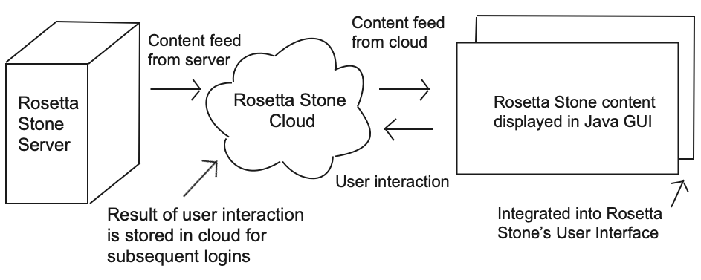
High-Level Design - Part 1
Notes:
The high-level design of the Java GUI involves the content being fed from Rosetta Stone's server to the Cloud and then from the Cloud to the clients home computer.
As the software program is interacted with by the client, the result of that interaction is saved in the Cloud for the next time the client logs on.
At the clients location, Rosetta Stone's User Interface (UI) is integrated with a Java Graphical User Interface for the drop-down list functionality.
28

Slide 17
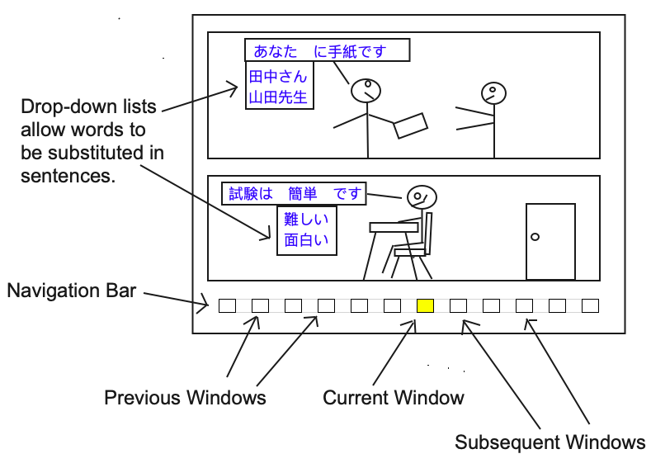
High-Level Design Part 2
Notes:
As for the client's UX (User Experience), drop-down lists in sentences show a variety of words that can be substituted with a particular word.
The navigation bar at the bottom of the screen shows the current window as being highlighted in yellow. From there, it's possible to view the user's progress through the current part of the program.
28

Slide 18
Implementation Plan
Work Breakdown Structure (WBS)
Schedule (includes Gantt Chart)
Validation
Evaluation and Continuous Improvement
Legal, Ethical and Cultural Considerations
Notes:
Here's the plan for implementing the idea into a working software program.
A Work Breakdown Structure (WBS) outlines the Milestones and tasks (called work packages) that need to be performed to implement the project.
The schedule and Gantt chart are a visual representation as far as time concerning when the tasks will be performed.
From there, steps are taken to ensure the final product is valid. Also it's evaluated towards the goal of continually improving the product.
Considerations are made to ensure the final product is in compliance with local & federal laws. Also that it's not perceived in any way as being unethical and agrees with everyone as much as possible from a cultural standpoint.
28

Slide 19
Work Breakdown Structure
Analysis
Draft requirements specifications
Identify word substitution alternatives for selected sentences
Meet to discuss proposed changes with focus group of native language speakers
Review & approve requirements during stakeholder meeting
Cross-platform design
Complete common UX design for Windows, Mac, and Linux
Design client-end software
Java development
Code the Java for the User Experience
Integrate with Rosetta Stone’s cloud API
Integrate with Rosetta Stone’s website
Test the updated software
Multi-Platform Development
Conduct end-to-end test across all software platforms (Windows, Mac & Linux)
Conduct beta tests with selected native speakers and learners of target language.
Evaluate UX scenarios for readability, sentence rationality, and quality of word substitutes
Deployment
Issue updated instructional manual
Deploy updated program to cloud
Issue surveys to clients to rate improvements & quality of overall program functionality
Complete deployment
Notes:
The Work Breakdown Structure divides the project into 5 milestones; they are Analysis, Cross-platform design, Java development, Multii-Platform Development, and Deployment.
Each milestone is divided into several work packages. Upon completion of all work packages in a milestone, then that particular milestone has been achieved.
Upon completion of all milestones, the entire project is complete. From there, steps are taken to ensure the finished product remains intact well into the future.
28

Slide 20
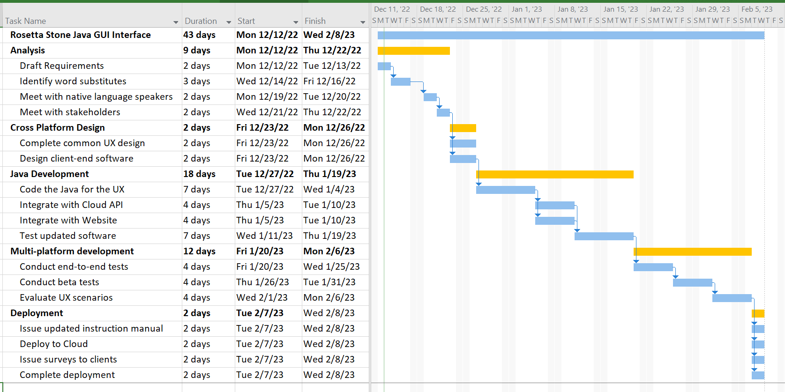
Schedule
See WBS (previous slide) for complete work package names.
Notes:
The schedule is the alpha-numerical portion of the diagram on the left. It shows the start and end dates of each milestone and work package, along with the duration.
The graphical portion on the right is the Gantt chart. The blue horizontal lines indicate the start and end times of the work packages. The arrows pointing downward indicate that a particular task has to finish before another can begin.
An exception to this is the horizontal blue line on the very top. It represents the entire project duration.
The yellow horizontal lines represent a milestone of which each consists of two or more work packages.
28

Slide 21
Validation
Review word substitution for each language separately
Individually test software on Windows, MacIntosh & Linux
Current user interface will undergo regression testing upon integration of drop-list list functionality.
Ensure parts of program that shouldn’t be affected operate the same as previously.
For located errors, investigate possibility of similar errors in other parts of the code.
End-to-end validation testing
Software update blends smoothly with the overall program
Transfer of data from cloud database to client workstation
Storage of updated user info into cloud database
Beta testing with test group of native speakers & learners of target language
Notes:
As far as validation, the word substitutions for each language (French, Italian, Chinese, etc) need to be evaluated separately.
The software needs testing to be performed on a variety of commonly-used software platforms.
The updated software needs to work well by itself as well as along with the software that was in place prior to the update. It also needs to function well across the network to the Cloud.
Finally, beta testing should be performed with native language speakers of a particular language package. Also with users who are studying the target language.
28

Slide 22
Evaluation and Continuous Improvement
Ongoing monitoring and evaluation
Customer feedback related to drop-down feature
Security concerns reported related to drop-down feature
Bug reports & new feature requests submitted to Rosetta Stone
Speed of responsiveness of drop-down entries to mouse clicks
Rate of data flow between Rosetta Stone cloud & client workstation
Comparison of User Interface across platforms
Continuous improvement
Investigation into making the software available on a variety of IoT (Internet of Things) devices
Creation of software package in other languages
Request for new features evaluated; possibly incorporated into next release
Bug report evaluation, prioritized and response via the company’s regular update cycle
Capacity of server, database and network upgraded as necessary
Incorporation of updates into new languages per company decision to adopt additional languages
Notes:
To ensure ongoing quality, the newly-produced software product will continue to be monitored and evaluated in several different ways. Among these are customer feedback, security reports related to the software, and responsiveness of the software to user input.
As far as continuous improvement, the request for new features will be evaluated and if considered worthwhile, incorporated into new software releases. Also regular updates will at least partially be in response to bug reports that are received. Additionally, it would be good to make it available in other languages and operatable on many types of IoT (Internet of Things) devices.
These are just a few of the ways that the software package will be continuously improved.
28

Slide 23
Legal, Ethical and Cultural Considerations
Legal Consideration
Data privacy laws domestically and abroad
Potential for liability risk
Language training certification issues for schools and businesses
Ethical Considerations
Impact on non-adult language learners from language learning scenarios
Confidentiality of user information
Prompt feedback to customer concerns
Cultural Considerations
Reaction of cultural groups towards language-learning scenarios
Inclusion of a variety of cultural groups in language-learning scenarios
Behavior of Rosetta Stone staff and employees towards various cultural groups during project implementation
Notes:
Once the software product is on the market, it's important to be sure that it's legal, ethical and works well with cultures that are exposed to it.
For legal considerations, a few things to consider are how it measures up in terms of allowing privacy and not causing liability issues.
As far as ethics, it's necessary to ensure the software package doesn't compromise personal customer info. Also that feedback to customers concerns are fast.
As far as cultural considerations, it's important to think about how people of different backgrounds will react to it. Instead of finding it to be offensive, it's ideal that it be something they'll embrace.
To the left are listed possibly only a few of the legal, ethical and cultural considerations that need to be looked into prior to deployment.
28

Slide 24
Incorporation of Feedback
Robert Nunez suggested using AI (Artificial Intelligence) to track user performance. From there, it could be used to personalize tests towards the goal of strengthening the weaknesses of the language learner. Evaluating the current platform, I’ve decided the current software platform does an adequate job of retesting the learner on his or her weak areas.
James Baldemor suggested that acronyms like GUI (for Graphical User Interface) be spelled out. This is because of the likelihood of people not readily understanding the word that each letter of the acronym is meant to represent. I agreed that it would be advantageous to spell it out. So I went back to look for the first occurrence of each acronym and that’s where I spelled it out
James Baldemor also suggested editing the schedule and Gantt chart in order to make it more concise. I abbreviated the work package names in order to make them all fit on one line. I also checked software tools that would make the Gantt chart’s timeline narrower while retaining visual clarity. Thus I was able to accomplish his suggestion to make both schedule & Gantt chart fit on one slide.
Notes:
Two of my classmates offered feedback on this project.
Robert suggested that I make use of AI (artificial intelligence) to keep tabs on user performance. From there, the user could be tested on areas in which he or she doesn't perform well. I decided that Rosetta Stone's current platform does a good job of retesting a user on areas wherein previous performance wasn't good.
James suggested that acronyms like GUI for Graphical User Interface be spelled out. I decided to go ahead and adopt this change. It's because I do believe there's a potential for certain persons to not understand acronyms that are related to technical jargon, no matter how basic they may seem to be.
James also suggested I make efforts to get the entire schedule & Gantt chart fit on one page. I took steps to make it smaller both vertically and horizontally. To my surprise, I was able to make it all fit on one page. What's more, all the text on it is readable from a reasonable distance.
28

Slide 25
Career Readiness
My career goal: software developer
Career skills learned or enhanced by the project:
Evaluating an area of technology and identifying potential improvements.
Collaborating with others to refine the quality of a project presentation
Assess different technology approaches for a project and choosing the best one
Developing a plan to implement a project
Using the project to further career goals:
Post project on my career portfolios website at https://www.elevatedandsuspended.me
Update my LinkedIn profile with a link to the project
Prepare to discuss the project with potential employers
Notes:
As far as career readiness, the project does a great job of helping to prepare my for the job market.
My goal is to become a software developer. I think the project does a great job of familiarizing myself with events that occur routinely in the software industry.
Among other skills, I've learned to cooperate with classmates and co-workers concerning the details of a project. Also with being able to find areas of technology that could possibly stand some kind of improvement.
A few things I'll do to further career goals is to post this presentation on my career portfolio website. I'll also put a link to this project on my LinkedIn profile.
28

Slide 26
Conclusion
Rosetta Stone can help clients achieve their language learning goals more quickly through the use of word substitution in their software program
An updated Graphical User Interface (GUI) will enable the addition of drop-down lists which can show several word substitutes alternatives
The updated User Interface can allow changes in grammar in be incorporated into the word substitutes
Technical approach recommended is the development of a Java GUI interface which interfaces with Rosetta Stone’s current interface
A high-level design for the updated user interface was presented
Proposed solution can be fulfilled within 2 months
Notes:
Wrapping things up, adding word substitution in their software programs is a way that Rosetta Stone clients can achieve their language learning goals that much faster.
An updated GUI would enable drop-down list functionality in order to show several word substitutes.
An updated UI can allow changes in grammar to be reflected in the word substitutes.
A Java GUI that interfaces with Rosetta Stone's current interface is the recommended technical approach.
This presentation showcased a high-level design for such a Grapical User Interface.
The implementation for this can be fulfilled within 2 months.
28

Slide 27
References - Part 1
Crowdbotics. (n.d.). Estimate cost to build an app Retrieved from https://www.crowdbotics.com/build-an-app
Data Flair (n.d.) Pros and Cons of Java Data Flair https://data-flair.training/blogs/pros-and-cons-of-java/
Data Science Learner (n.d.) 6 Pros and Cons of Using SQL (and 2 Tips for Getting it Right) Retrieved from https://www.datasciencelearner.com/pros-and-cons-of-using-sql/
Eversoft (2021, March 9) The Pros and Cons of Java – 9 factors to consider if you’re thinking about using Java for your projects. Eversoft https://eversoft.company/blog/the-pros-and-cons-of-java-9-factors-to-consider-if-youre-thinking-about-using-java- for-your-projects/
Hartman, J (2022, November 5) Java Swing Tutorial: How to Create a GUI Application in Java Retrieved from https://www.guru99.com/java-swing-gui.html
Indeed Editorial Team (2022, March 11) 10 Uses of SQL (With Definition, Benefits and Examples) Retrieved from https://www.indeed.com/career-advice/career-development/sql-uses
Plunkett Research. (2022). Company profile: Rosetta Stone Ltd. Retrieved from https://plunkettresearchonline- com.devry.idm.oclc.org/ResearchCenter/Company.aspx?Comid=11491&Industry=43&Gen=%20&Keyword=%22Rosetta+Sto ne%22&43
Notes:
This is the first part of the list of references
<number>

Slide 28
References - Part 2
revel. (September 30, 2014) Sentence Structure and Substitution Techniques in Language Learning. Retrieved from https://interpretiveeslteachingblog.wordpress.com/2014/09/30/sentence-structure-and-substitution-techniques-in- language-learning/
Rosetta Stone (2020) Official Rosetta Stone® - Language Learning Retrieved from https://www.rosettastone.com
Statista (n.d.) Rosetta Stone brand awareness, usage, popularity, loyalty, and buzz among online education service users in the United States in 2022 Retrieved from https://www.statista.com/forecasts/1338203/rosetta-stone-online-education- brand-profile-in-the-united-states
thenewboston (2009, October 3) Java Programming Tutorial - 69 - Drop Down List Program [Video] Youtube. https://www.youtube.com/watch?v=XS4-5GmRnp8
Work, N. (2014). Rosetta Stone: Compatible with proficiency-oriented language instruction and blended learning. International Journal of Technology in Teaching and Learning, 10(1), 35-52
[1] zyBooks, a Wiley brand. (2020). 2.2 Introduction to graphical user interfaces https://learn.zybooks.com/zybook/Business_Application_Programming_with_Lab_-_60392/chapter/2/section/2 (accessed 2022)
Notes:
This is the second part of the list of references
<number>

