Slide 1
CEIS 110 Introduction to Programming
Course Project – Data Manipulation and Analysis

Slide 2
Data
Along with the IoT (Internet of Things) growing in the number of connected devices as time goes forward, so is the amount of data generated from various sources.
This project covers the manipulation and analysis of data in the IoT.
A IoT temperature & humidity sensor will be used to gather data. Data from it will be analyzed; from the data predictions can be made. Also the data can be made into charts that illustrate how the data changes over the course of time.

Slide 3
The tools to be used for working with data:
Software:
Spyder (for writing programs in Python)
Microsoft Excel
Arduino IDE
Hardware:
Arduino Mega board
Cable to connect Arduino to the PC
Breadboard
Wires
DHT11 sensor (detects temperature & humidity)
resistor (optional)

Slide 4
Inventory – hardware items used in the project
DHT11 Temperature & Humidity Sensor
Arduino Board
Breadboard
Wires
PC to PC Megaboard cable

Slide 5
Arduino IDE
Arduino IDE is used to communicate with and gather data from the DHT11 sensor

Slide 6
Microsoft Excel
Microsoft excel can be used to save data in a comma separated value file. Such a file can be saved as a regular Excel spreadsheet in which the data can be manipulated.

Slide 7
Spyder
One of several applications that could be used to write programs in Python.
Python will be used to make charts and graphs from the spreadsheet program.

Slide 8
Systematic process for data gathering & analysis – Inputs, processes, outputs
The chart to the right depict the inputs, outputs and processes upon with the flowchart for the procedure will be based.

Slide 9
Flowchart
Flowchart created based on the systematic process of the previous slide.
Upon software installation, the data gathering process begins. The data is then manipulated in various software programs in order to achieve the end goal of analyzing it to develop graphical models.

Slide 10
Software prep for DHT11 Sensor
The DHT_sensor_library.zip and Adafruit_Sensor_master.zip files needed to be added in Arduino in order to use the DHT11 sensor with the Arduino.

Slide 11
Monitoring Temperature and Humidity
The DHT11 sensor to detect temperature and humidity, the picture is a map that is used to shows how it’s connected to the Arduino board.
The data sensor pin on the DHT11 sensor (the middle pin) is connected to ground.
The right hand pin is VCC, which is connected to 5V on Arduino.
Left hand pin is GND; is connected to GND on Arduino.

Slide 12
DHT11 Temperature & Humidity Sensor
Pinout of the sensor when the device is resting face up

Slide 13
DHT11 Sensor connected to Arduino Board
So the little blue circuit board (in the background) is the DHT11 Sensor. It’s sticking up vertically from out of the breadboard.
It’s that sensor that detects temperature and humidity.
The following slide shows the serial monitor, which outputs info from the DHT11. It depicts the humidity & temperature lowering while I’m holding a cold pack next to the DHT11.

Slide 14
Converting temperature & humidity to a file
// DHT Temperature Sensor - Marvin Ziegler
#include <DHT.h>
#define DHTPIN 5 // what pin we're connected to
#define DHTTYPE DHT11 // DHT 11
// Initialize DHT sensor for normal 16mhz Arduino
DHT dht(DHTPIN, DHTTYPE);
void setup() {
Serial.begin(9600);
dht.begin();
}
void loop() {
float h = dht.readHumidity();
// Read temperature as Celsius
float t = dht.readTemperature();
// Read temperature as Fahrenheit
float f = dht.readTemperature(true);
Serial.print("Temp in C= ");
Serial.print(t);
Serial.print(", Temp in F= ");
Serial.print(f);
Serial.print(", and ");
Serial.print("Humidity in percent = ");
Serial.println(h);
delay(1000);
}
This is the code that was run in Arduino to convert data picked up by the DHT11 sensor, which can be viewed on the serial monitor.

Slide 15
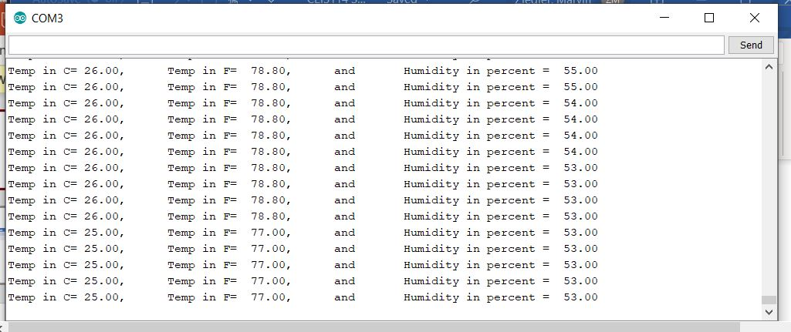
Serial Monitor of DHT11 Circuit
The serial monitor is a display of the output of the DHT11 Sensor
The picture depicts temperature & humidity becoming lower. This is going on while I’m holding a cold pack next to the DHT11 Sensor.

Slide 16
Saving data collected to a csv file
#Purpose: Save data from an arduino into file using python
#Name: Marvin Ziegler
#Date: August 7, 2020
#filename = myfile.txt
import serial
port_addr='COM3' # com port of the arduino
baud='9600'
file_name='mydata.txt' # this file will be saved in the same location as the py file
with serial.Serial(port_addr,baud) as port, open(file_name,"w+", 256) as outf:
for i in range(200): #read 200 lines into the file
fullline = port.readline()
line = str(fullline)
outf.write(line)
outf.write('\n')
outf.flush()
This is the SaveSerial.py file which was used in Spyder.
It converted data picked up by the DHT11 sensor to a comma separated value (csv) textfile by the name of mydata.txt.
It’s called a csv file since temp in Celsius, Fahrenheit are separated by commas before Humidity is written as the final value on each line.
It reads in 200 lines of data, which is sufficient for analyzing and making graphical models.

Slide 17
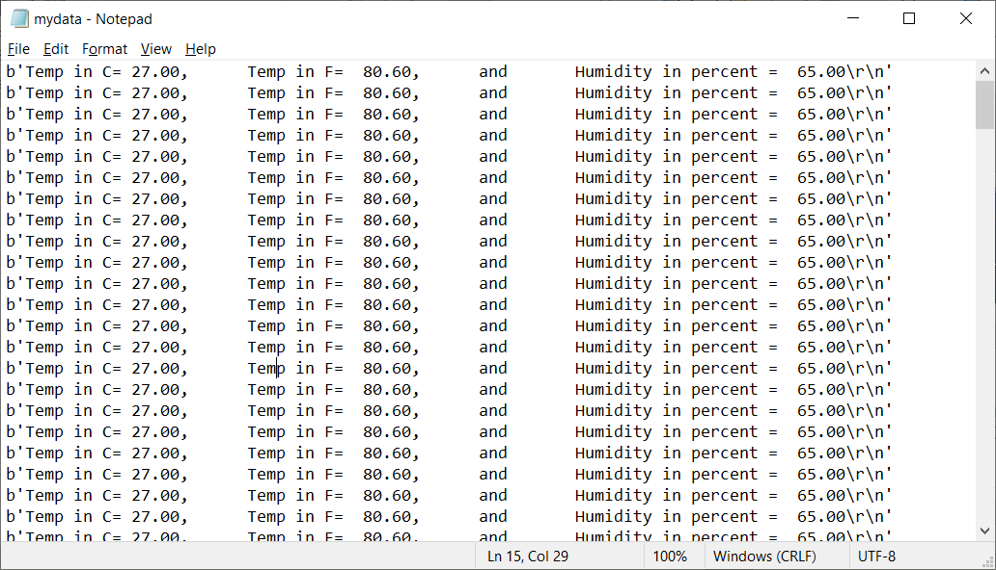
csv file created by Python
Text (csv) file created from running python program while collecting data from DHT11 sensor.

Slide 18
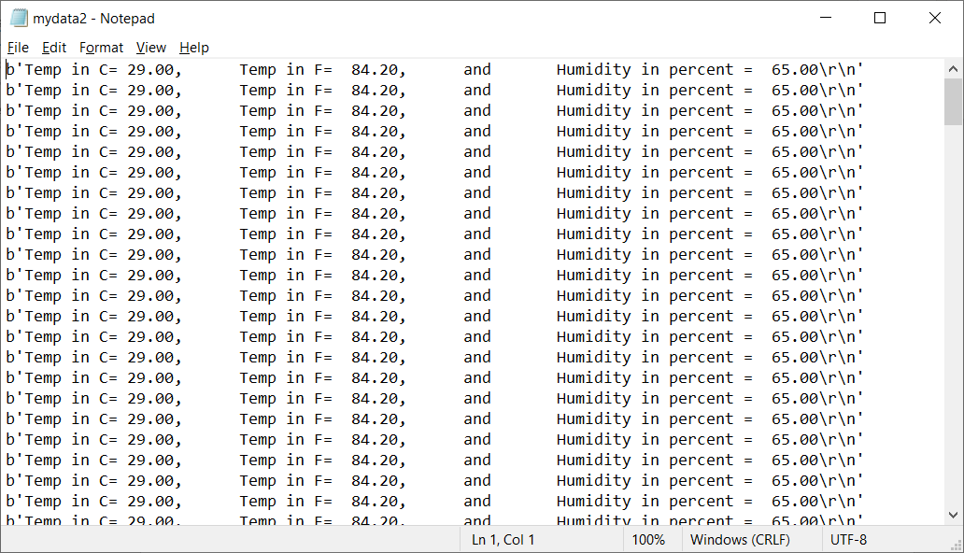
Another csv file created by Python
I ran this one while holding my finger against the DHT11 sensor. So the temp & humidity readings are slightly different.

Slide 19
Data Cleansing
It’s possible for there to be a few lines of data that aren’t consistent with the other lines when the text file is created. For example, lines 1 & 2 in the attached picture aren’t consistent.
These should be deleted.
Deleting such inconsistent lines is what’s known as data cleansing.

Slide 20
#Purpose: Cleanse data from Arduino and store in python list
#Name: Marvin Ziegler
#Date: August 10, 2020
#filename = formatdata.csv – can be opened in Excel
cList=[]
fList=[]
hList=[]
input_file_name='mydata.txt'
output_file_name='formatdata.csv' #will be created in the same directory
with open(input_file_name) as inf:
for line in inf:
s=line.split(',')
cList.append(float(''.join(n for n in s[0] if n.isdigit() or n=='.'))) #extract data to lists
fList.append(float(''.join(n for n in s[1] if n.isdigit() or n=='.'))) #only extract numbers
hList.append(float(''.join(n for n in s[2] if n.isdigit() or n=='.')))
with open(output_file_name,"w+") as outf:
outf.write('Celsius,Fahrenheit,Humidity')
outf.write('\n')
for i in range(len(cList)):
outf.write(str(cList[i])+',')
outf.write(str(fList[i])+',')
outf.write(str(hList[i])+'\n') #print data to file separated by commas
CleanseData.py file – a python file whose purpose is to transfer the data that was converted to a comma separated value text file to a comma separated value file that can be opened by Microsoft.
The resulting Excel file can be saved as a regular Excel file (with a file extension of xlsx), but the Excel csv file (with a file extension of csv) still exists.

Slide 21
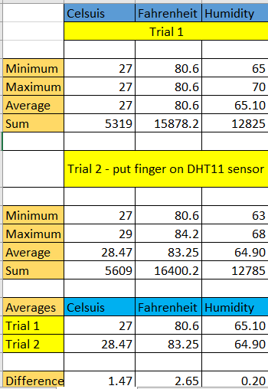
Using the data in excel
In Excel, it’s possible to perform various calculations on the data.
The picture shows how the average is slightly different for all three values for when I put my finger on the DHT11 sensor.

Slide 22
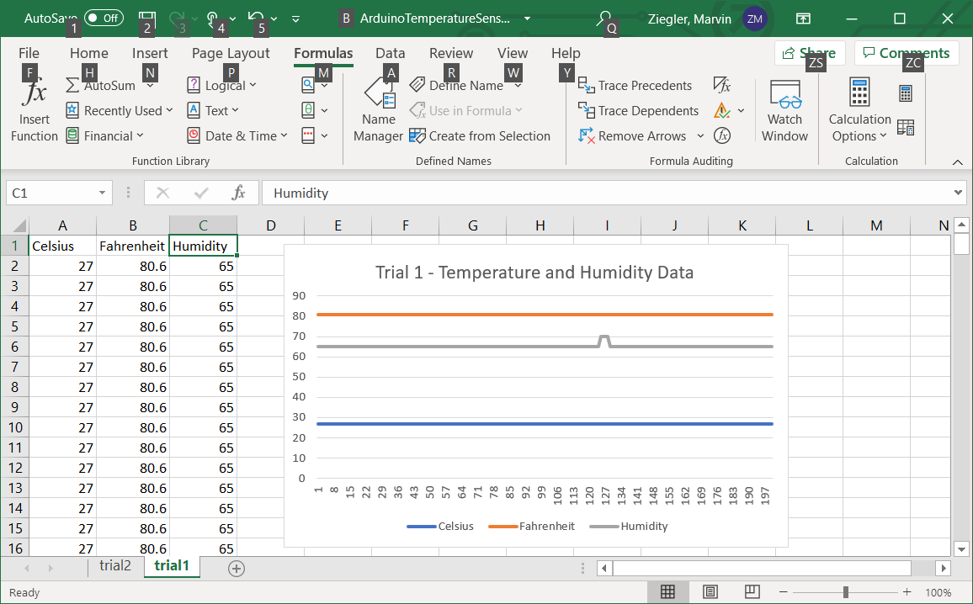
Graph in Excel
Read Data into CSV format
This is the Excel Spreadsheet that has been derived from the mydata.txt file via the CleanseData.py file (on slide 20).
The python file saved it to a csv Excel file, it looked pretty much the same as this Excel spreadsheet. Yet I had to save it as a file with an xlsx extension to be able to create the chart in Excel which is depicted on the right.

Slide 23
Chart in Excel
Close up of chart created in Excel, which shows how temperature in Fahrenheit & Celsius compare to each other and also how they compare to Humidity.

Slide 24
Using matlabs in python to make charts for data analysis
Box plot for a trial at room temperature

Slide 25
Using matlabs in python to make charts for data analysis
Box plot for a trial involving using an air duster for computers to affect the temperature

Slide 26
Using matlabs in python to make charts for data analysis
Box plot for a trial involving using an air duster for computers to affect the temperature
I did this to answer the question of how does Celsius compare to Fahrenheit.
It seems like Fahrenheit changes temperature more drastically than Celsius. Perhaps this is because one degree Fahrenheit is about half a degree in Celsius.

Slide 27
Chart creation in Python
This code was used in Python to create a line chart to answer the question of how Celsius and Fahrenheit temperatures compare when hitting the DHT11 sensor with an air duster.
import pandas as pd
import matplotlib.pyplot as plt
df1 = pd.read_csv('formatdata12.csv') #Celsius
df2 = pd.read_csv('formatdata12.csv') # Humidity
plt.figure(); df1.Celsius.plot(label = "Celsius"); df2.Fahrenheit.plot(label = "Fahrenheit"); plt.legend(loc='best');
plt.suptitle("Celsius vs Fahrenheit for Trial 2")
plt.show(h)

Slide 28
Speculations & predictions to be derived from the data
If it were a rainy day, it would be cooler. So if it were 5 degrees cooler, then I believe both the lines on the chart for Celsius and Fahrenheit would follow the same pattern, but they would show it to be 5 degrees cooler.

Slide 29
Challenges
The most difficult part was getting the readings to vary from the DHT11 sensor. Touching it and blowing on it don’t seem to do much. The air duster and the cold pack had more effect.
Still working at becoming more skillful with making flowcharts in Visio.

Slide 30
Career skills
Writing code in Python for manipulating data and creating charts
Installing and using the DHT11 sensor.
Installing libraries which allow the Arduino IDE to talk to various types of sensors.

Slide 31
Conclusion
Learned how data can be gathered and manipulated using the Arduino, Microsoft Excel and Python.
Found that all parts of the process are quite enjoyable – the gathering of data into the DHT11 sensor, watching the data info display on the serial monitor, and also manipulating it with Excel and Python

Slide 32
Website
https://elevatedandsuspended.me

